Slide 1

Project Title - Seasonal Agriculture Performance Analysis
Subtitle: Analyzing Seasonal Patterns in Crop Yield, Resources, Environment and Economic Performance
Student Name: JANVI AGARWAL
College Name- AMBALIKA INSTITUTE OF MANAGEMENT AND TECHNOLOGY
AICTE STU ID : STU6a1fda8963b731780472457

Slide 2

PROBLEM STATEMENT
Agricultural performance varies across different seasons due to changes in environmental conditions, resource usage, crop selection and economic factors.
The project aims to analyze agricultural data across seasons to:
Compare crop yield and production across seasons
Study the effect of rainfall, temperature, humidity and soil conditions
Analyze fertilizer, pesticide and water usage
Compare revenue, cost and profit
Identify seasonal patterns, variations and unusual observations
Generate useful insights and recommendations for better agricultural planning

Slide 3
Project Description
Seasonal Agriculture Performance Analysis is a data analytics project based on agricultural records from different farms, crops, states and seasons.
The dataset contains 4,000 records and 28 attributes covering:
Farm and geographical information
Crop and seasonal information
Rainfall, temperature and humidity
Soil conditions and moisture
Fertilizer, pesticide and nutrient usage
Crop yield and total production
Market price, cost, revenue and profit
Water usage and water efficiency
Disease and pest risk
The data was cleaned and analyzed using Python and Jupyter Notebook. Statistical analysis and visualizations were used to identify relationships and differences between seasons.

Slide 4

WHO ARE THE END USERS?
Users
Farmers and agricultural planners
Agricultural researchers
Data analysts
Agricultural management organizations
Students and academic researchers
Decision-makers in agricultural planning
Uses
Identify high-performing seasons
Compare crop yield and production
Understand environmental patterns
Monitor resource consumption
Analyze water efficiency
Compare seasonal profitability
Identify disease/pest risk patterns
Support data-driven agricultural decisions

Slide 5

Technology Used
Other Tools:
VS Code — Project development
Git — Version control
GitHub — Project hosting and submission
Techniques Used:
Data cleaning
Exploratory Data Analysis (EDA)
Group-by analysis
Correlation analysis
Heatmaps
Box plots
Scatter plots
ANOVA statistical test
Outlier analysis
Programming Language:
Python
Tools & Libraries:
Jupyter Notebook — Data analysis and documentation
Pandas — Data manipulation and analysis
NumPy — Numerical operations
Matplotlib — Data visualization
Seaborn — Statistical visualizations
SciPy — Statistical analysis

Slide 6
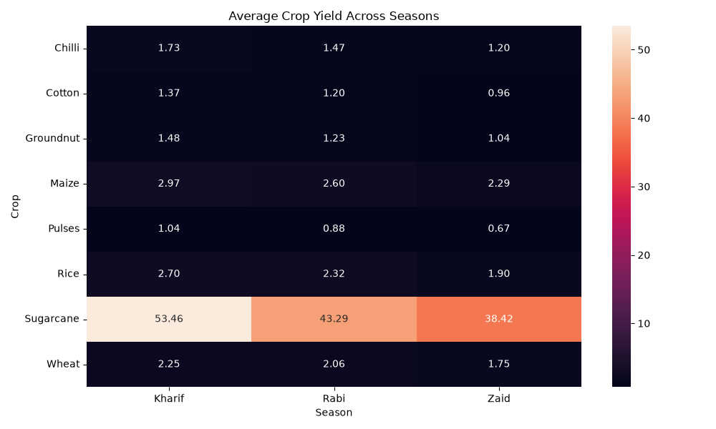
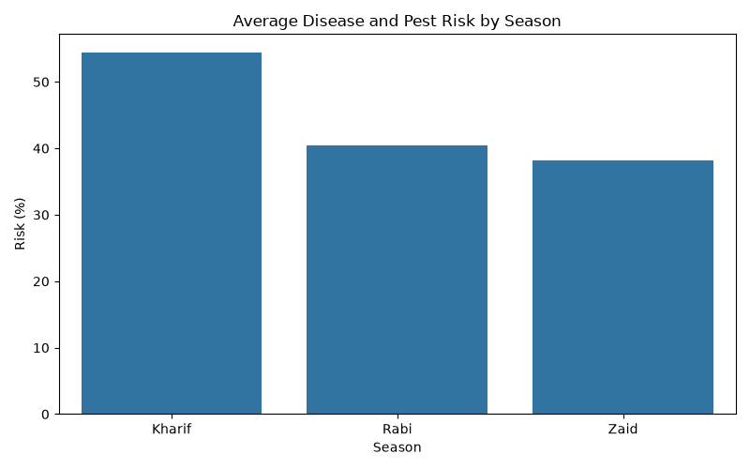
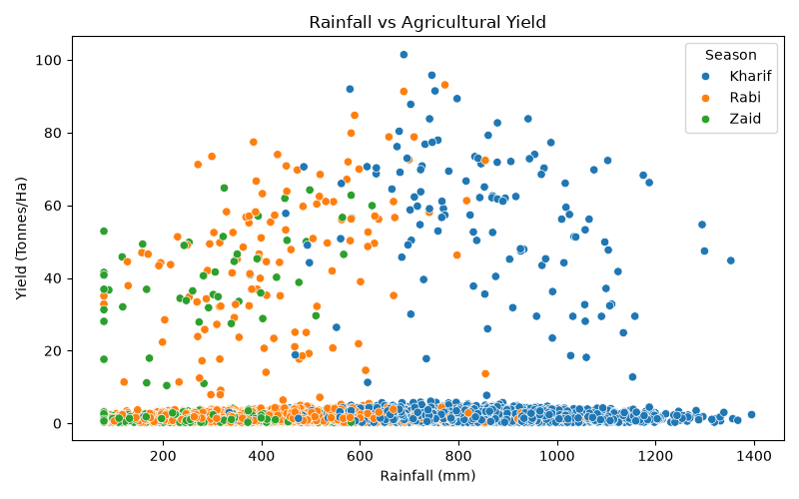
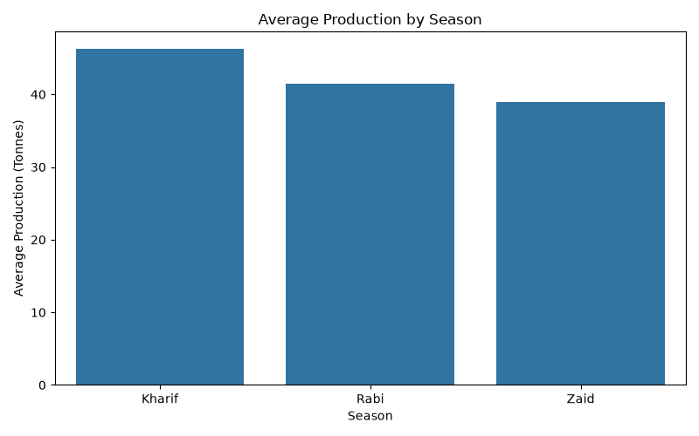
RESULTS
crop_season_yield_heatmap
disease_pest_risk_by_season
rainfall_vs_yield
production_by_season

Slide 7
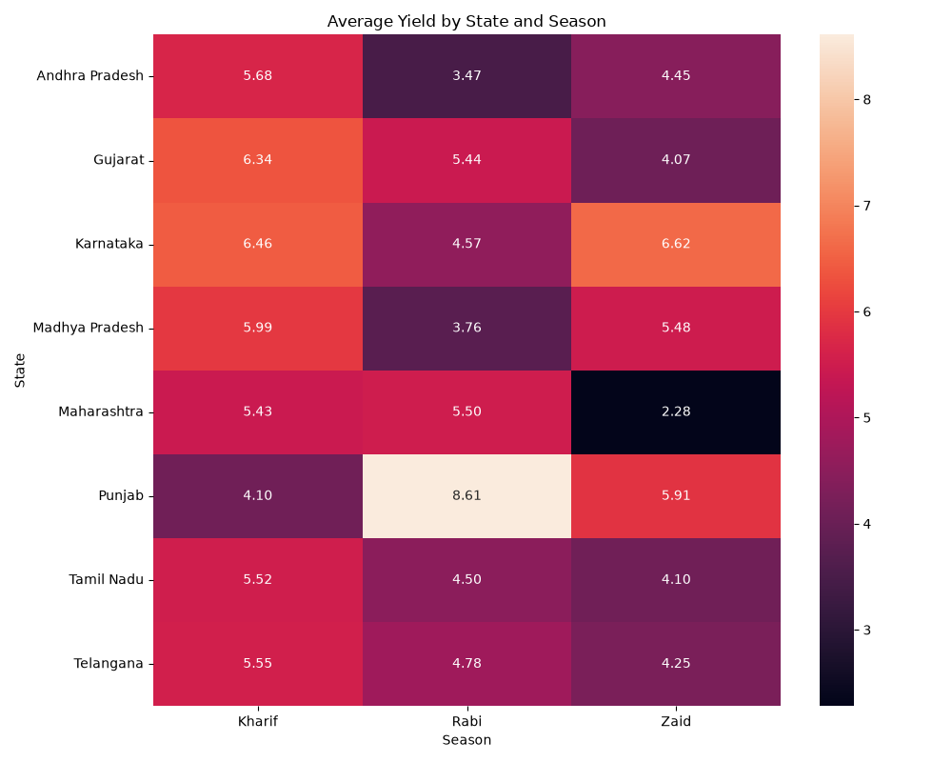
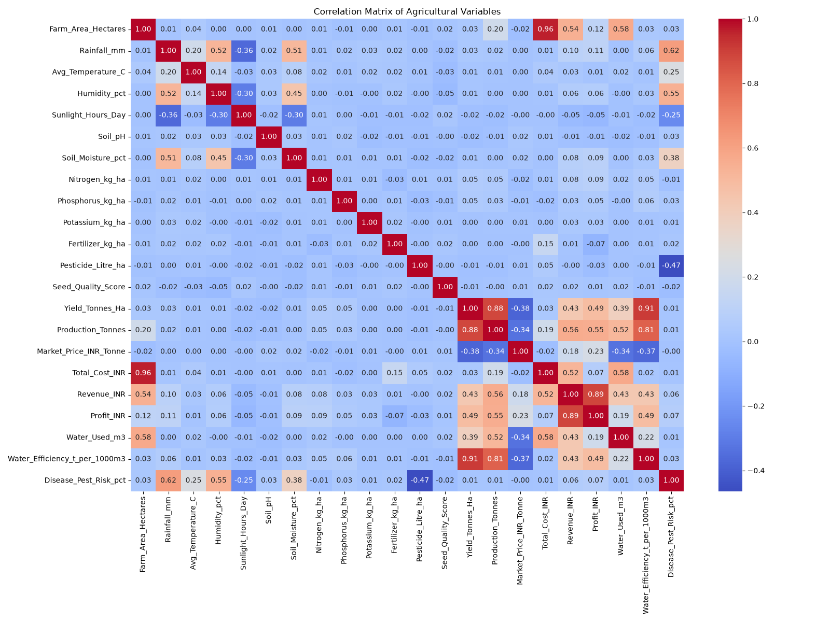
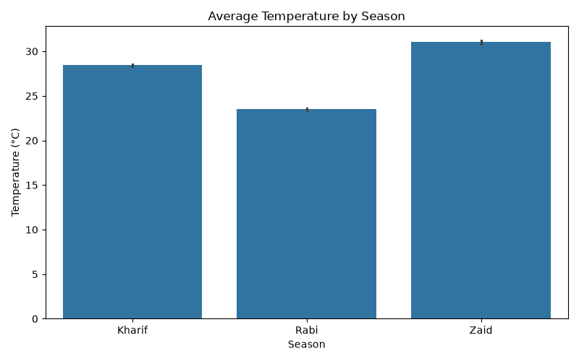
RESULTS
state_season_yield_heatmap
correlation_heatmap
temperature_by_season →

Slide 8
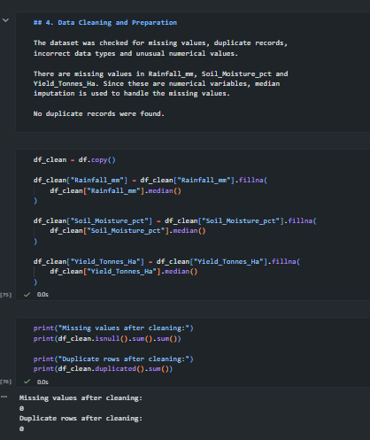
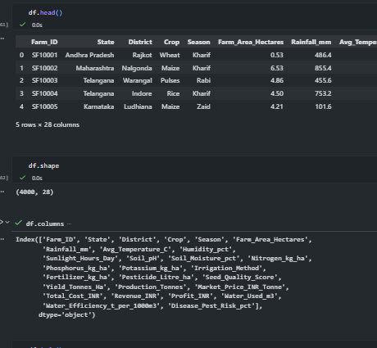
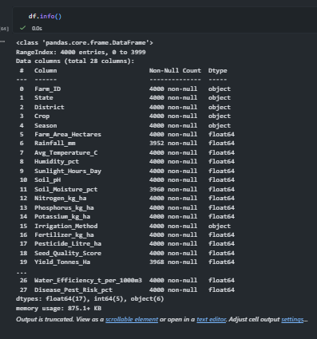
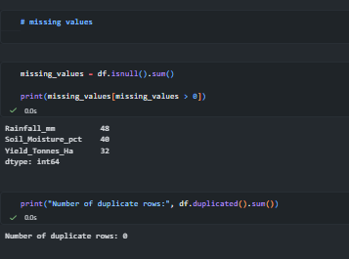
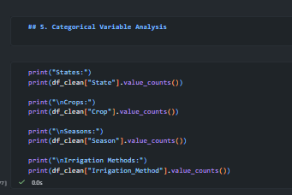
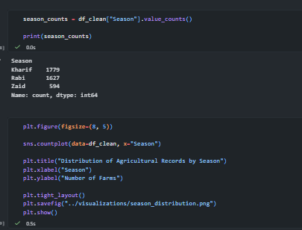
RESULTS

Slide 9
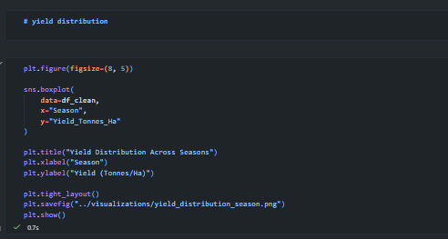
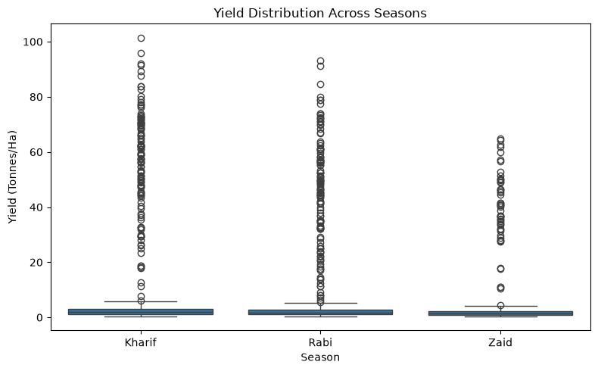
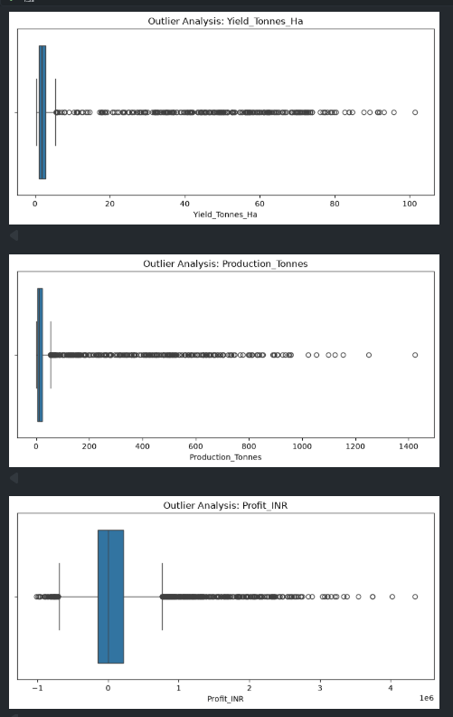
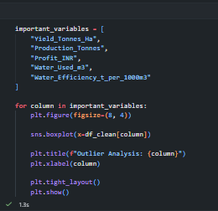
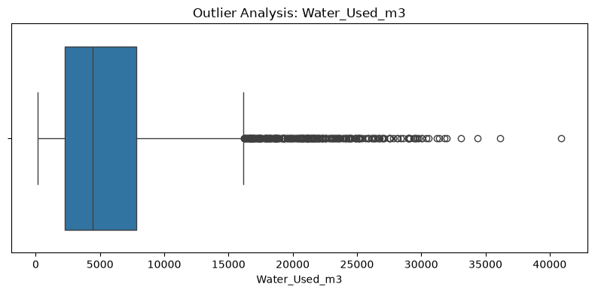
RESULTS

Slide 10
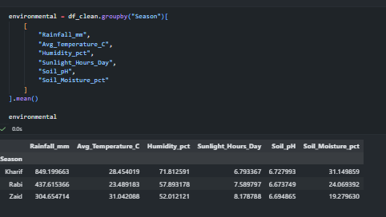
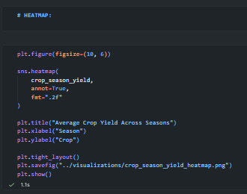
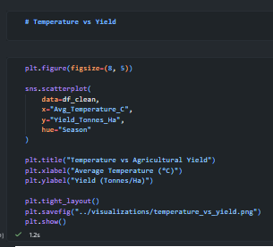
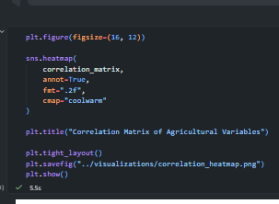
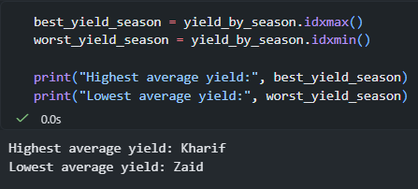
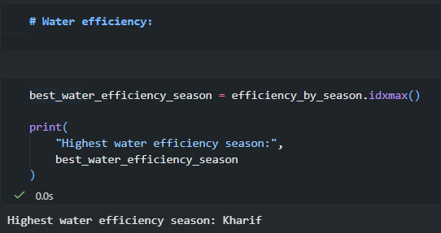
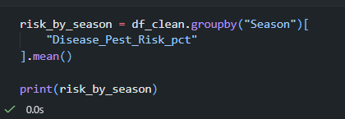
RESULTS

Slide 11
Future scope
Develop a real-time agricultural monitoring system using live weather and environmental data.
Apply machine learning models to predict crop yield and seasonal performance.
Integrate weather forecasting to support better seasonal planning.
Develop crop-specific recommendations for fertilizer, irrigation and resource usage.
Use IoT sensors to monitor soil moisture, temperature and other field conditions.
Build an interactive web/mobile dashboard for farmers and agricultural planners.
Extend the analysis with larger datasets from multiple years to identify long-term seasonal trends.
Develop an early-warning system for disease and pest risks.

Slide 12
GitHub Link
https://github.com/Janvi24-ux/Seasonal-Agriculture-Performance-Analysis.git

Slide 13
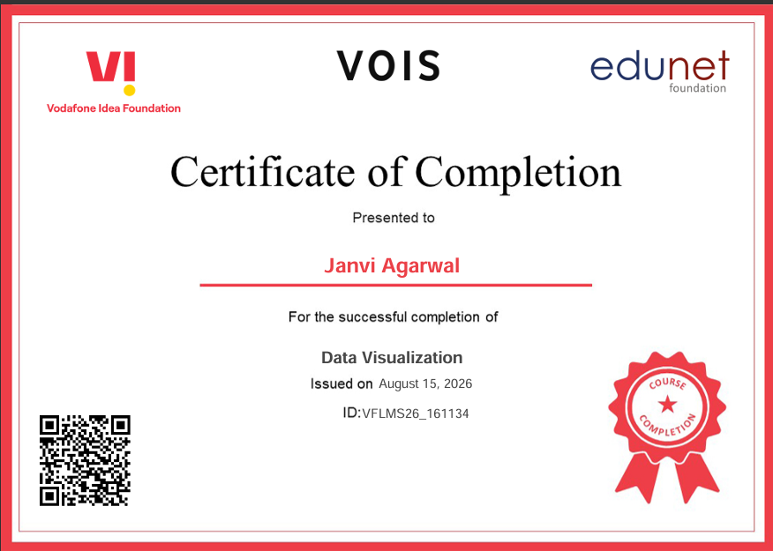
VOIS Course completion certificate -
Course name- Data Visualization

Slide 14
Thank you
THANK YOU!!
Seasonal Agriculture Performance Analysis
Presented by:
Janvi Agarwal
CSE – Data Science
GitHub Repository: https://github.com/Janvi24-ux/Seasonal-Agriculture-Performance-Analysis.git
Seasonal Agriculture Performance Analysis
.
.

